Slide 1



NEWYORK CRIME RATE DATA ANALYSIS
Data science Mid Project
Team Data geeks

Slide 2
Team Members
Pavani Billapati
Vishnupriya Doddapaneni
Trilok Kumar
Gowthami Middela

Slide 3
OBJECTIVE
Aim of this study is to scrutinize crime rates in New York City provided by NYPD and design predictive models using Linear regression and Neural networks.

Slide 4

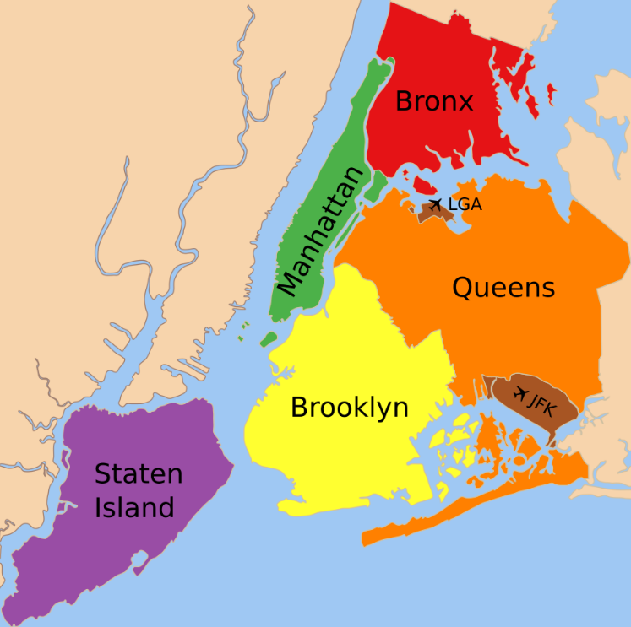



New York city is divided into 5 major regions

Slide 5




Each Region differs in lifestyle, demographics, wealth which eventually has an effect on type of crime & rate

Slide 6
Focus
To identify cities given specified percentage of crime rates.
Difference in the crime rates in different regions of Newyork.

Slide 7
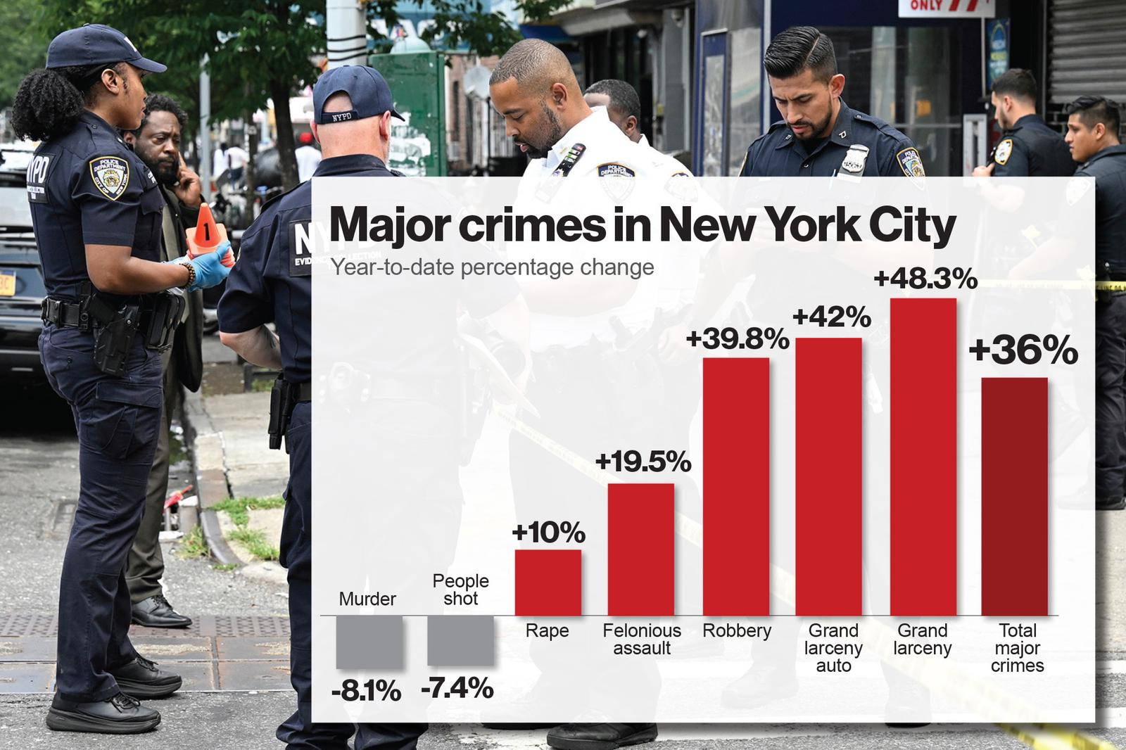
Statistics

Slide 8
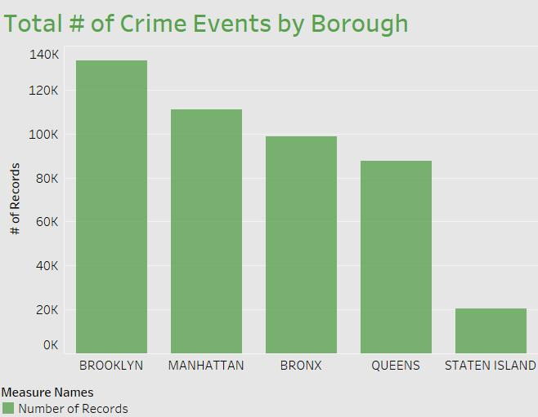

Slide 9
Data
NYPD Complaint Data
Source - Kaggle
Information about type of offense, time of occurrence, specific region.
Contains 24 features

Slide 10
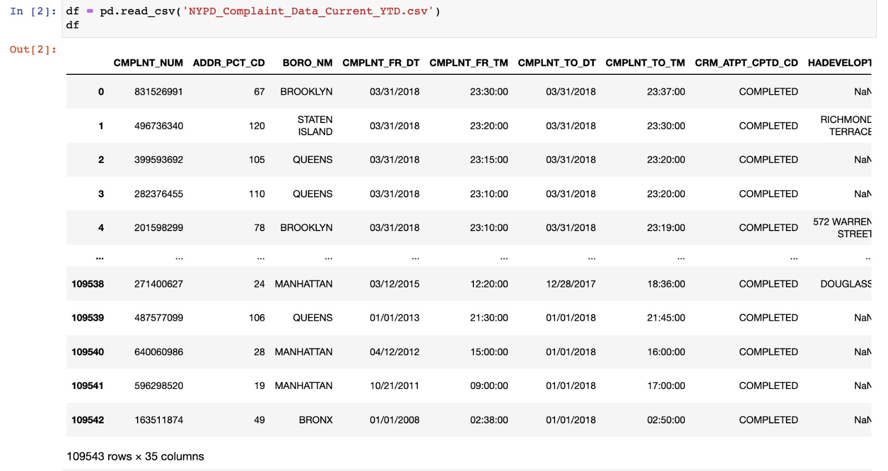

Slide 11
Realtime usage
It is useful for NYPD
For predicting the crime hotspots
Taking precautionary measures
To bring awareness among the general public

Slide 12
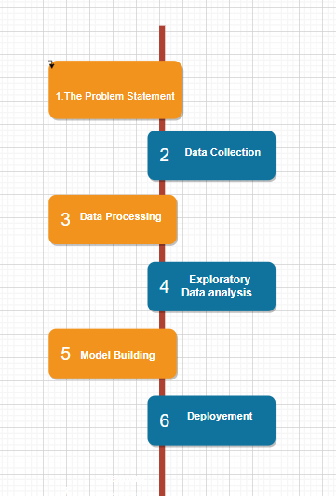
Workflow Diagram

Slide 13

Problem Statement
Defines the point you hope to solve or the impact you hope to make with your work.
What is the problem that you are trying to solve?”
should be clear, concise, and define a measurable outcome.

Slide 14

Data Collection
Depends upon the problem selected
IOT system - various sources such as a file, database, sensor
Kaggle
UCI Machine Learning Repository

Slide 15
Data Processing
Involves cleaning raw data
80/20 rule is used i.e., very data scientist should spend 80% time for data pre-processing and 20% time to actually perform the analysis

Slide 16
Exploratory Data Analysis
Identify obvious errors, as well as better understand patterns within the data, detect outliers or anomalous events, find interesting relations among the variables.

Slide 17
Model Building
Develop data sets for training, testing, and production purposes.
enable data scientist to develop analytical method and train it using algorithms, while holding aside some of data for testing the model.
We are using Linear Regression Model

Slide 18
Evaluation
Evaluation
Accuracy
Precision
Recall
F1 score

Slide 19
Deployment
We are planning to develop a user interface that can take crime rate percentage as input & display the list of cities that match.

Slide 20
Thank you...

